Slide 1
VISION
Submitted in the partial fulfillment for the award of the degree of
BACHELOR OF ENGINEERING
IN
CSE (AIML)
Submitted by:
Jahanvi Chawla 18BCS6108
Yuvraj Koundal 18BCS6114
Sejal Gulati 18BCS6116
Sachin Kaushik 18BCS6119
Shivam 18BCS6138
Under the Supervision of:
MONIKA SINGH
Department of AIT-CSE
DISCOVER . LEARN . EMPOWER

Slide 2
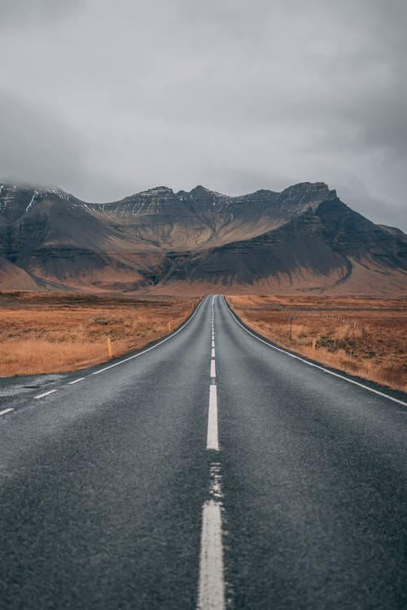
Outline
Introduction to Project
Problem Formulation
Objectives of the work
Methodology used
Results and Outputs
Conclusion
Future Scope
References

Slide 3
Introduction to Project:-
Every year, as more automobiles enter the road, the number of people killed or injured in car accidents rises. The question of how to drive safely when there are a lot of cars on the road and the roads are narrow has become a hot topic.
Lane detection is a prominent topic in machine learning and computer vision, and it's been used in smart vehicle systems. The lane detection system gathers data from lane markers in a complex environment and uses it to accurately predict the vehicle's position and trajectory in relation to the lane.
Lane departure warning (LDW), Lane Keeping Assist (LKA), and Adaptive Cruise Control (ACC) are examples of advanced driver assistance systems that can help people analyze their current driving environment and provide appropriate feedback for safe driving or notify the driver in dangerous situations.

Slide 4
Problem Formulation:
The difficulty in predicting the road traffic environment, however, is a bottleneck in the development of this system.
Likelihood of accidents is significantly higher than typical in the complex traffic environment when vehicles are many and speeds are excessive
Key perceptual signals of human driving in such a complex traffic condition are road color extraction and texture recognition, as well as road boundary and lane marking.
Lane detection, on the other hand, is critical in the lane departure warning system.
When it comes to line detection, we normally use one of two ways: feather-based methods or model-based methods.

Slide 5
Objectives:
We planned to study different model combinations so that we can make use of ML, Image Processing and Computer Vision.
Provided a new preprocessing method and ROI selection mechanism in this approach.
Learned how to make use of various machine learning and CV libraries.
Learned how to use media processing in order to work on video input.

Slide 6
Methodology
Preprocessing:
The video input is a RGB-based color image sequence obtained from the camera. A typical picture preparation approach is to smooth and filter graphics. The basic goal of filtering is to reduce image noise and improve the image's effect.
Color Transform:
Color model transform is an important aspect of machine vision, and it's also crucial for lane detection. The actual road traffic environment, as well as the intensity of light, all cause noise that obstructs color detection. We can't tell the difference between white lines, yellow lines, and vehicles in the backdrop.

Slide 7
Methodology Contd..
Color Extraction:
We added this feature extraction module to the preprocessing stage to improve the accuracy of lane detection. It is to maintain any lane-related features while removing non lane-related ones. It focuses on extending feature extraction to color.
Edge Detection:
Edge detection is done again after the lane identification and ROI selection in the second. This detection enhances lane detecting accuracy even more. Using the updated Canny edge detection technique, this portion primarily performs overall edge detection on the frame image. We did this two times, the first time is to extract a wide range of edges throughout the full frame image.

Slide 8
Methodology Contd..
ROI Selection:
To get rid of these unnecessary edges, identify a polygon's visual area and only save the visible region's edge information. We can used an adaptive area of interest (ROI) on the image to reduce image redundancy and algorithm complexity. The input image is only set on the ROI area and this strategy can improve the system's speed and accuracy.
Feature Extraction:
Feature extraction is very critical step. Canny transform, Sobel transform, and Laplacian transform are some of the most frequent edge detection methods. But we chose Canny transform because it is superior.

Slide 9
Methodology Contd..
Lane Detection:
Lane detection is divided into two types: lane edge detection and linear lane detection. This part provides the fundamental lane detection functions and conducts lane detection based on the proposed ROI selection and better preprocessing.

Slide 10
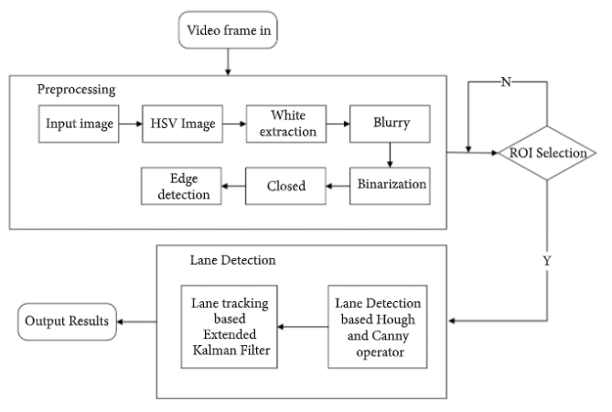

Slide 11
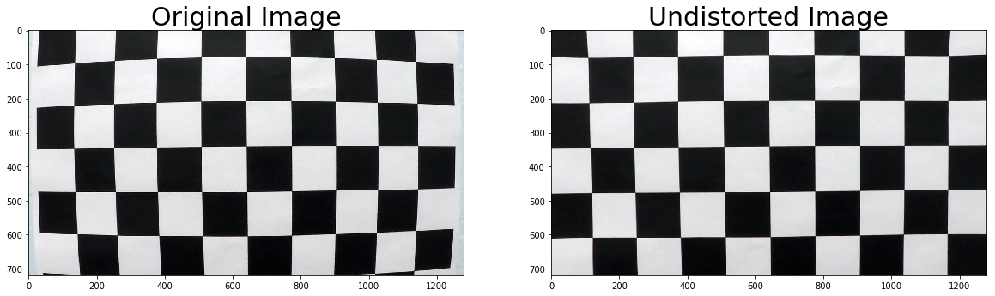
Let’s see another method
Distortion coefficients and camera calibration matrix:
Lenses are used in all cameras, and one of the issues with lenses is that they have radial distortion. I calculated the correct camera matrix and distortion coefficients using OpenCV functions on chessboard images to remove the distortion. Finding the interior corners of an image and using that information to un-distort the image is one way to accomplish this. As shown in the below fig.

Slide 12
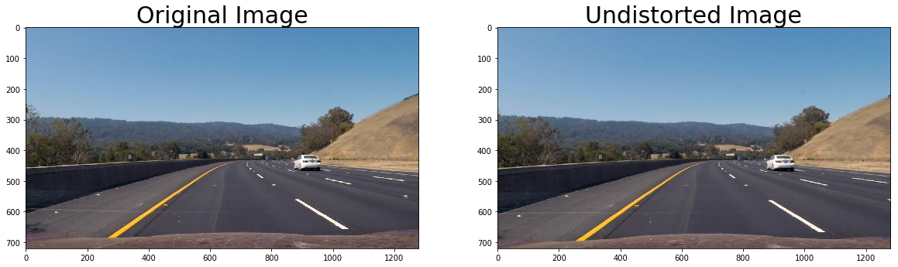
Applying distortion correction to raw images:
It may be more difficult to discern the impacts of adding distortion correction to raw photos compared to a checkerboard image, but if you look closely at the white automobile that has been slightly cropped along with the trees when the distortion correction was performed, this effect becomes more visible. As shown in the below fig.

Slide 13
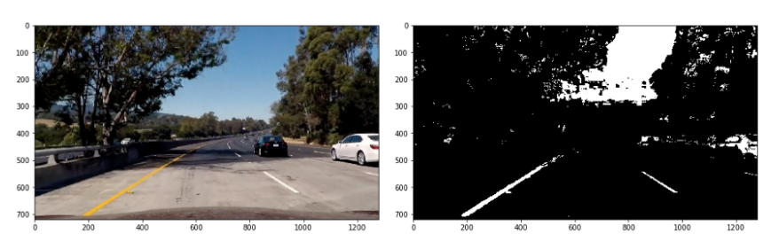
Creating a threshold binary image:
We used a combination of thresholds, color spaces, and gradients to test a number of these strategies on a variety of photographs. To build my image processing pipeline, we chose the following components: To detect lane lines, use S channel thresholds in the HLS color space and V channel thresholds in the HSV color space, as well as gradients. As shown in the below fig.

Slide 14
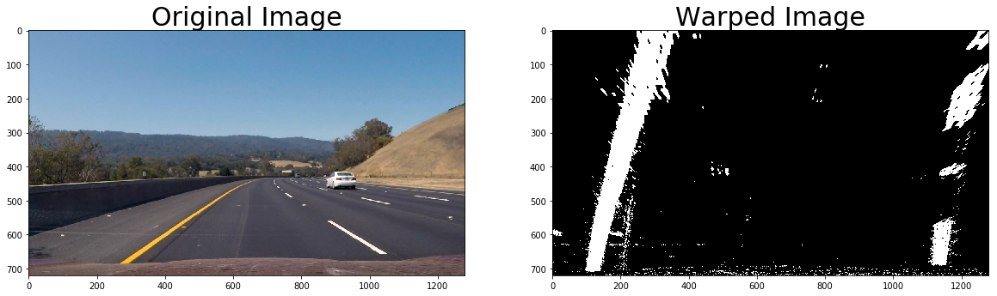
Wrap perspective:
Images have perspective, which makes straight lines in an image appear to be converging at a distance despite the fact that they are parallel. When this perspective is gone, it is simpler to detect lane line curvature. This is accomplished by converting the image to a 2D Bird's Eye view, in which the lane lines are always parallel to one another. We selected four spots on the original undistorted image and altered the perspective to a Bird's eye view, as seen in fig.

Slide 15
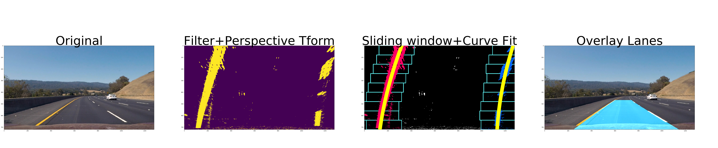
Lane detection:
There are a few different methods for detecting lane lines. We’ve utilized convolution, which is the result of multiplying two signals: the window template and the vertical slice of the pixel image. To apply the convolution, we’ve utilized a sliding window approach, which maximizes the amount of heated pixels in each window. The image is moved across the window template from left to right, and any overlapping values are added together to create the convolved signal. The biggest overlap of pixels occurs at the peak of the convolved signal, and this is the most likely location for the lane marker.

Slide 16
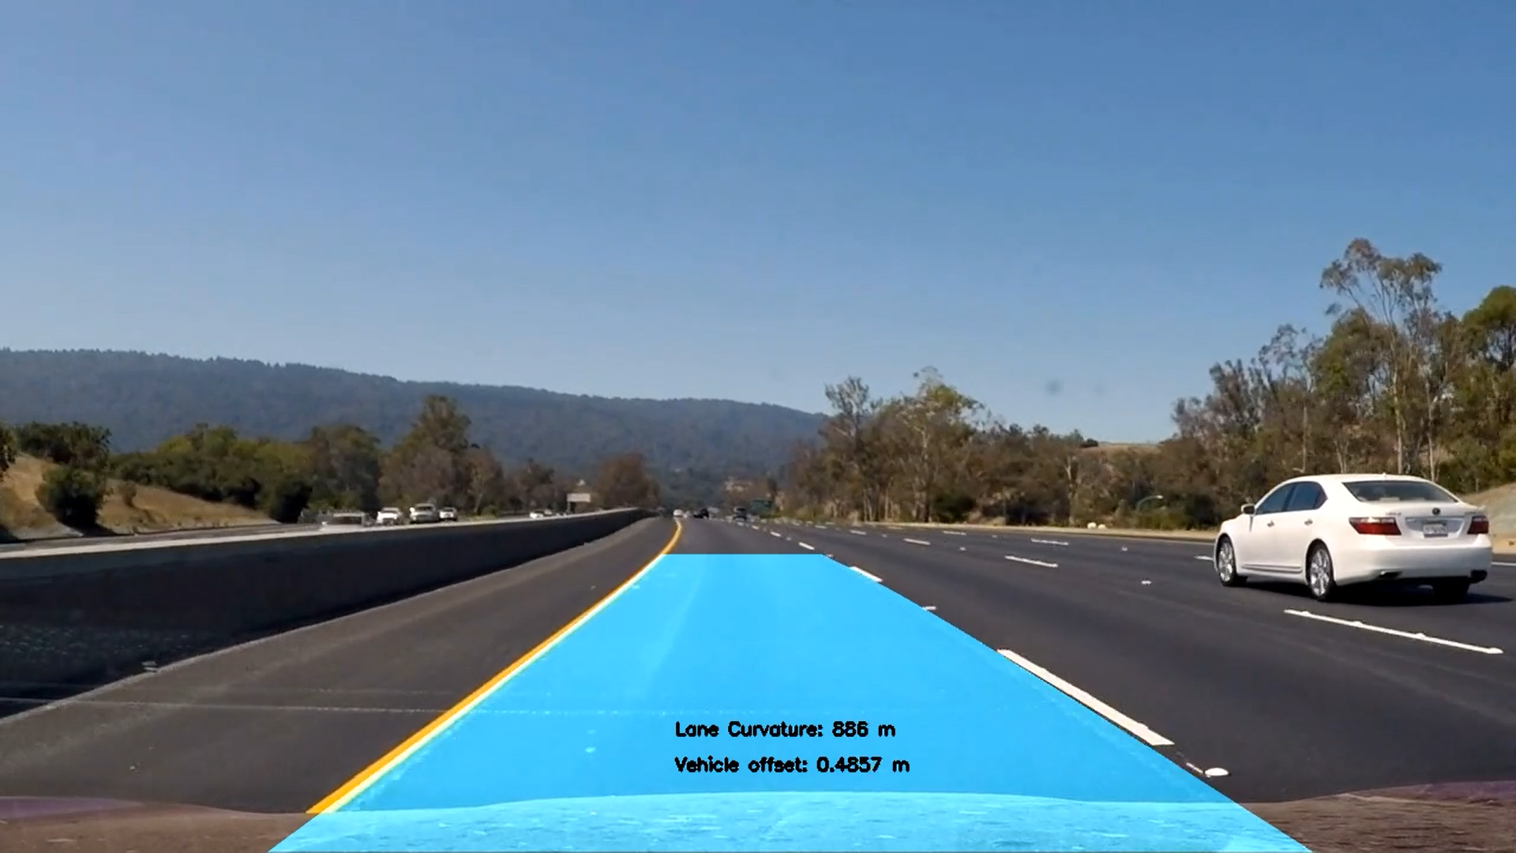
Additional things in 2nd method
Lane's curvature and the vehicle's location in relation to the car's centre:
We've taken measurements of the lane lines and calculated how much the road is curving, as well as the vehicle's position in relation to the lane center. We've assumed the camera is situated in the vehicle's center.

Slide 17
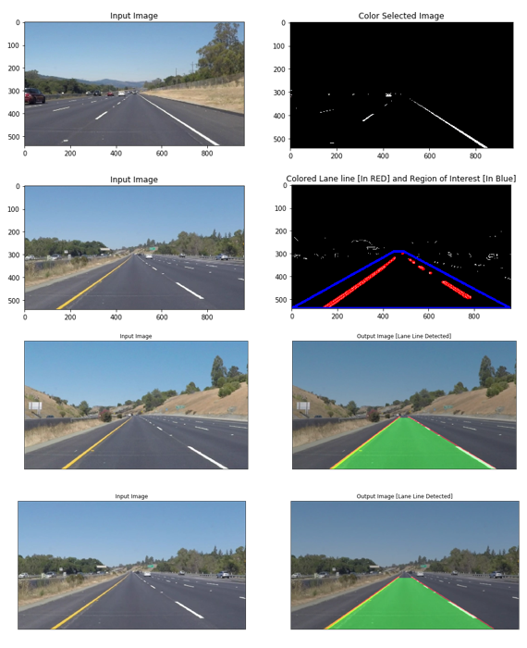
Method-1 Results
Results and Outputs

Slide 18
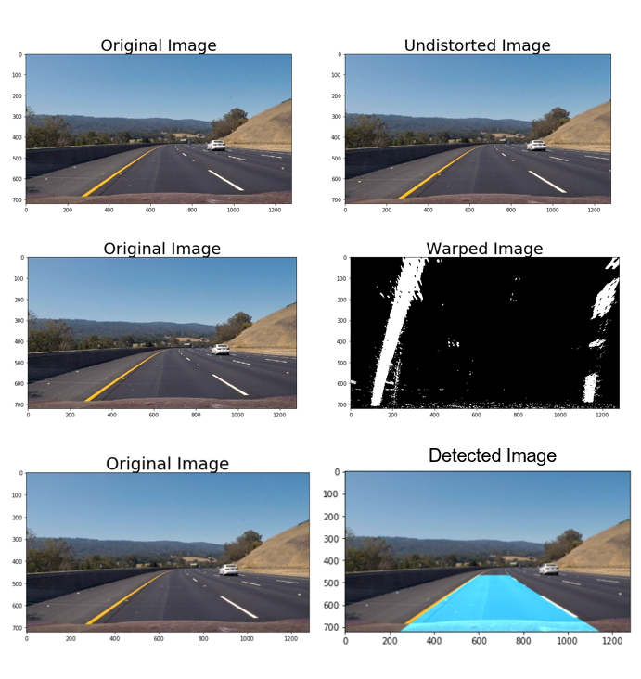
Method-2 Results

Slide 19
Conclusion
We proposed a new lane detection preprocessing and ROI selection methods to design a lane detection system.
The main idea is to add white extraction before the conventional basic preprocessing.
Edge extraction has also been added during the preprocessing stage to improve lane detection accuracy.
We also placed the ROI selection after the proposed preprocessing.
Compared with selecting the ROI in the original image, it reduced the nonlane parameters and improved the accuracy of lane detection.

Slide 20
Future Scope
‘Vision’ would be used in almost every self-driving vehicle such that it increases its accuracy and use domain over the time.
In the near future, eventually every vehicle would be integrated with an automated driving feature and for that to be possible our project i.e., ‘VISION’ would be playing an important role.
It could be applied to public transport vehicles so that they can be automated to drive themselves.

Slide 21
References
https://www.hindawi.com/journals/am/2018/8320207/
https://towardsdatascience.com/lane-detection-with-deep-learning-part-1-9e096f3320b7
https://www.ijeat.org/uploads/papers
https://www.researchgate.net/publication/332298502_A_Computer_Vision_based_Lane_Detection_Approach
https://iopscience.iop.org/article/10.1088/0957-0233/17/4/020/meta
https://ieeexplore.ieee.org/abstract/document/5476151
https://www.sciencedirect.com/science/article/abs/pii/S0031320315004690

